Slide 1
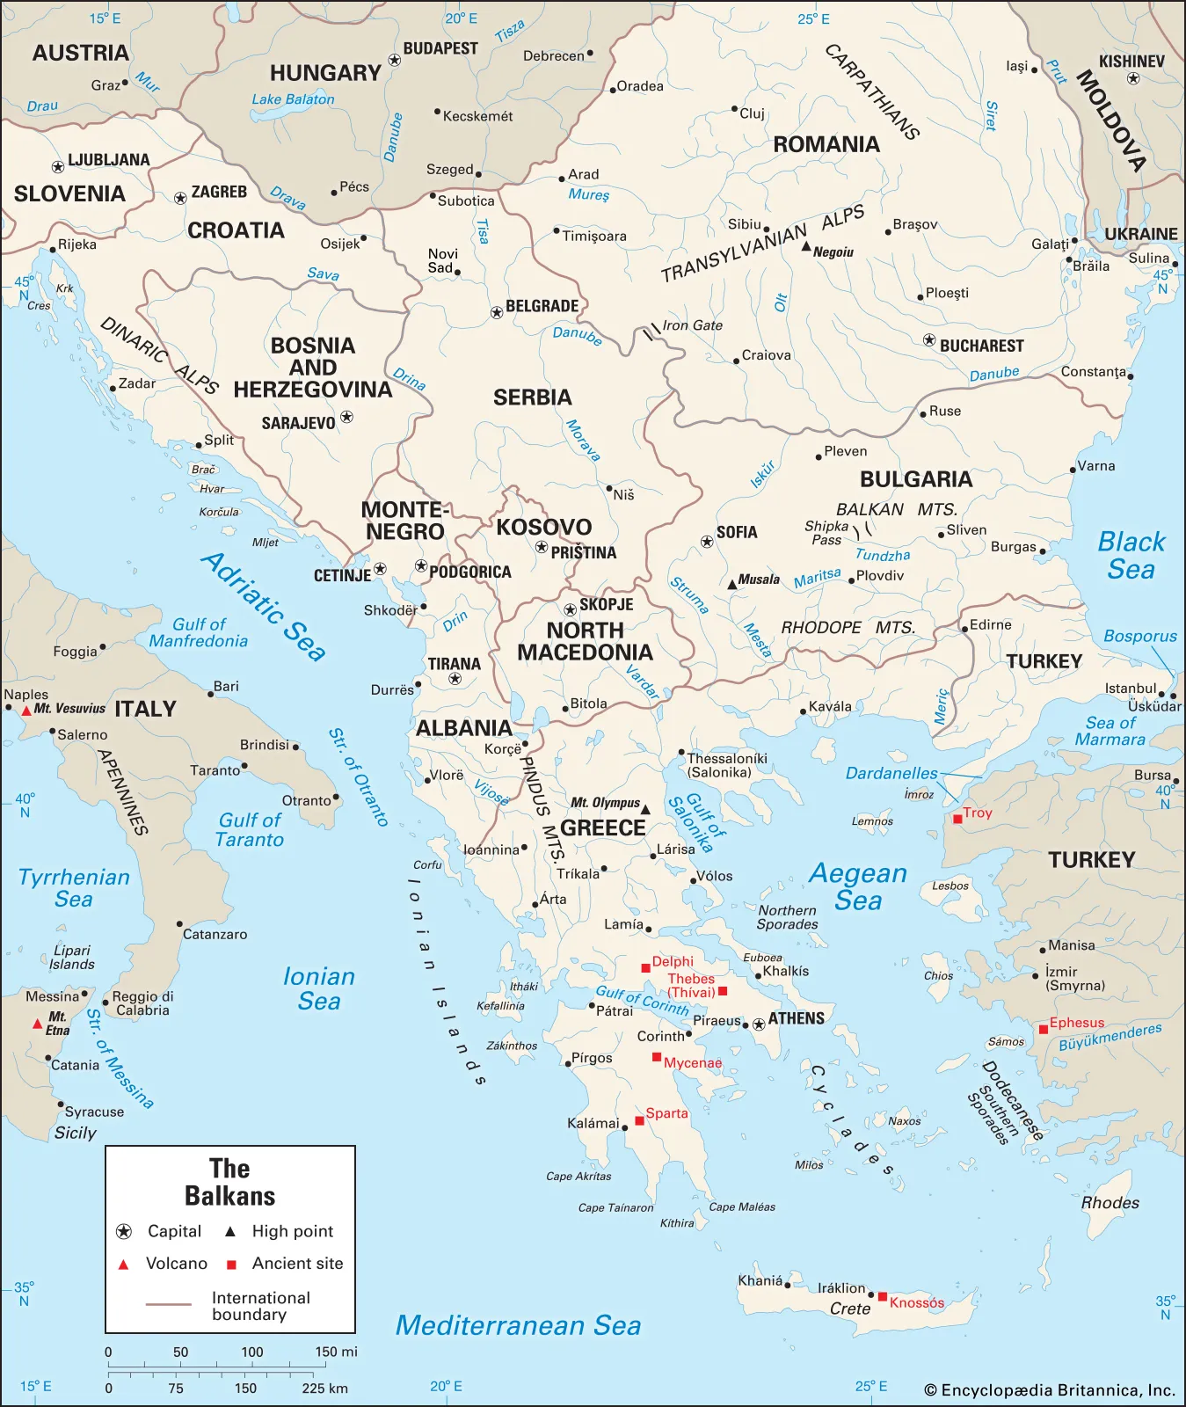
Integrative Project
Adriano Soldera
Andrei Popescu
Cristian-Petru Marza
Eric Tiganasu
Totally Legit Balkans
+Italy
Encyclopædia Britannica, Inc. “Balkans.” Encyclopædia Britannica, https://www.britannica.com/place/Balkans/In-the-Roman-Empire#/media/1/50325/110370. Accessed 29 Jan. 2025.

Slide 2
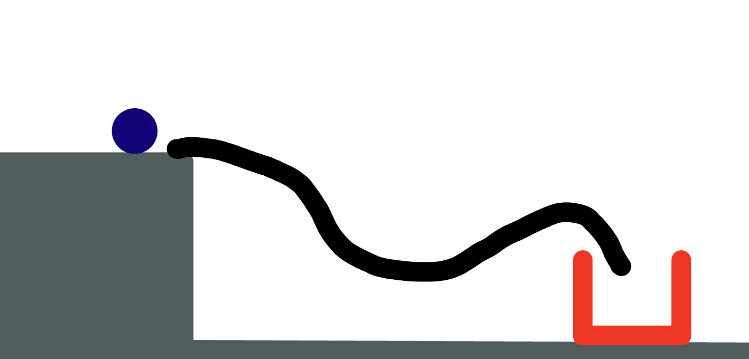
Physics Drawing
-Adriano’s Idea
Puzzle Solving Game
Runs on 2D Physics Engine
Takes into account gravity, collisions, and object interactions
*asset drawn by team

Slide 3
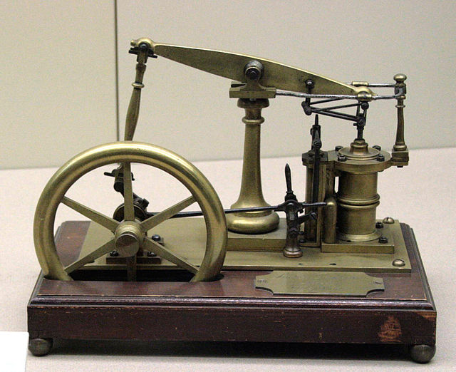
Steam
Engine
Andrei’s idea
Simulating the mechanical movement of a steam piston engine
Touching on the concepts of:
Force over time
Pressure vessels
Heat transfer
Mechanical engineering of the valve gear
Inputs:
Changing the amount of fuel in the firebox
Moving the throttle and reverser
Tamorlan. “Model of a beam engine.” Wikimedia Commons, 12 Apr. 2007, https://commons.wikimedia.org/wiki/File:JamesWattEngine.jpg. Accessed 29 Jan. 2025.

Slide 4
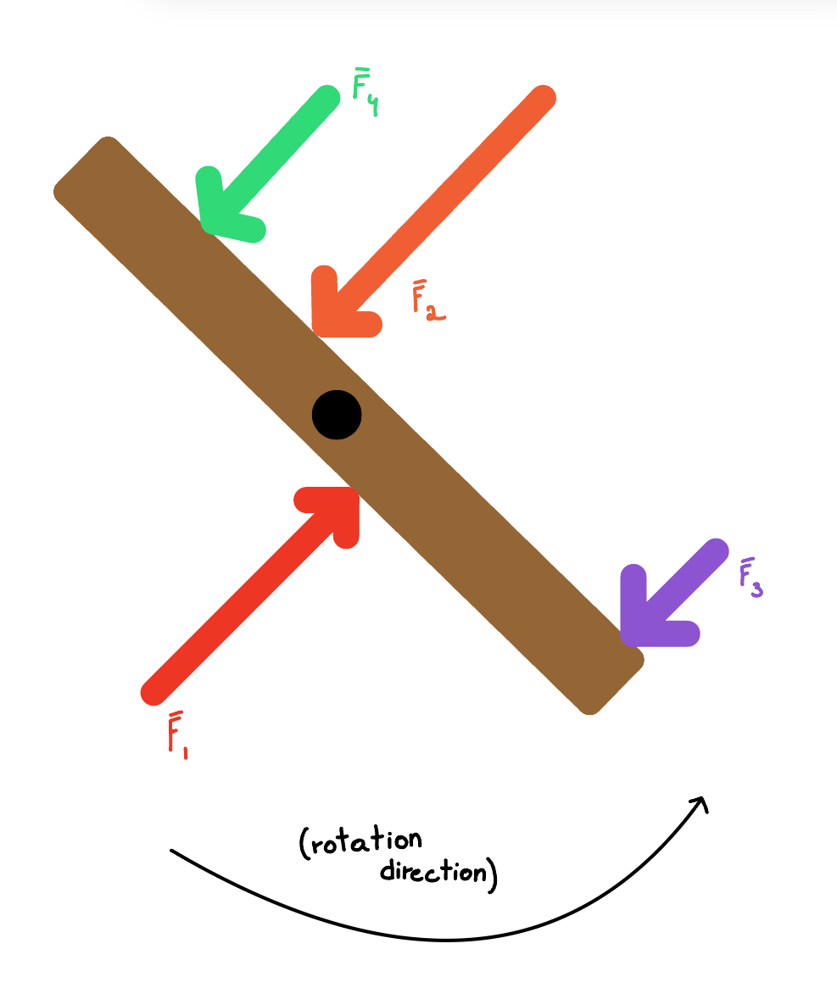
Torque
Simulator
-Cristian’s Idea
Program allowing the creation of a torque simulation
Torque
Rotational velocity
Generating energy with magnetism
*asset drawn by team

Slide 5
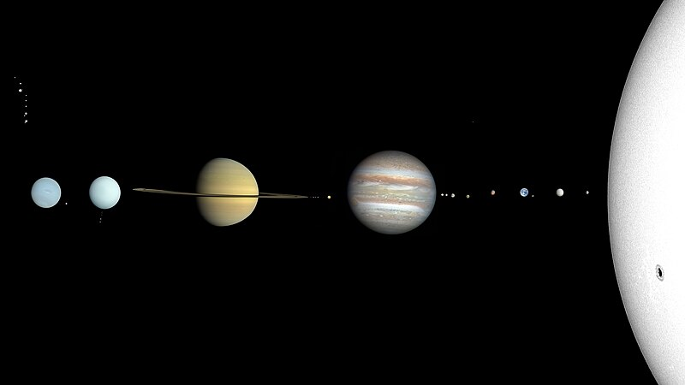
Space Simulator
-Eric’s Idea
CactiStaccingCrane. “OUR SOLAR SYSTEM IMAGINE.” Wikimedia Commons, 19 Apr. 2022, https://commons.wikimedia.org/wiki/File:Solar_System_true_color.jpg. Accessed 29 Jan. 2025.
Gravity (Newton’s Law of Universal Gravitation)
Planetary Motion (Kepler’s Laws)

Slide 6
Recap
Project Ideas | Description
Team Member’s name and Project Idea 1: | Adriano Soldera - Physics Drawing
Team Member’s name and Project Idea 2: | Andrei Popescu - Steam Engine
Team Member’s name and Project Idea 3: | Cristian-Petru Marza - Torque Simulator
Team Member’s name and Project Idea 4: | Eric Tiganasu - Space Simulator
Selected Project Ideas and why: | The chosen project is the Space Physics Simulator. This is because it is the most interesting idea, as the team felt that most people don’t realize both the scale and the overall behavior of space, and more specifically the solar system. In comparison to other ideas, the Space Physics Simulator allows for a project with multiple physical notions and multiple user inputs while being doable in the suggested time frame.

Slide 7
Advantages vs. Disadvantages
Rejected Ideas
Physics Drawing -> Time-consuming
Steam Engine -> Little possibilities for user interaction
Torque Simulator -> Singular physics notion
Space Physics Simulation
-> Feasible in allocated time
-> Lots of user interaction possibilities
-> Multiple physics and mathematical notions

Slide 8
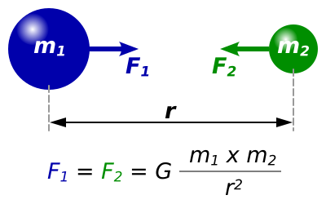
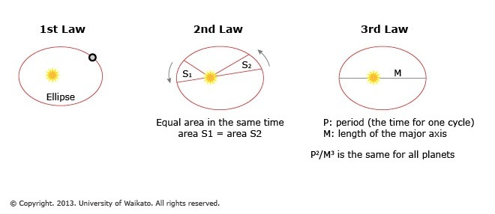
Concept
Newton's Law of Universal Gravitation
Kepler’s Laws
Vector Analysis
Dna-Dennis. “Gravitational constant equation.” Wikimedia Commons, 24 Jan. 2008, https://commons.wikimedia.org/wiki/File:NewtonsLawOfUniversalGravitation.svg. Accessed 29 Jan. 2025.
University of Waikato. “Kepler’s laws.” Science Learning Hub Pokapū Akoranga Pūtaiao, 27 Mar. 2013, https://www.sciencelearn.org.nz/images/277-kepler-s-laws. Accessed 29 Jan. 2025.

Slide 9
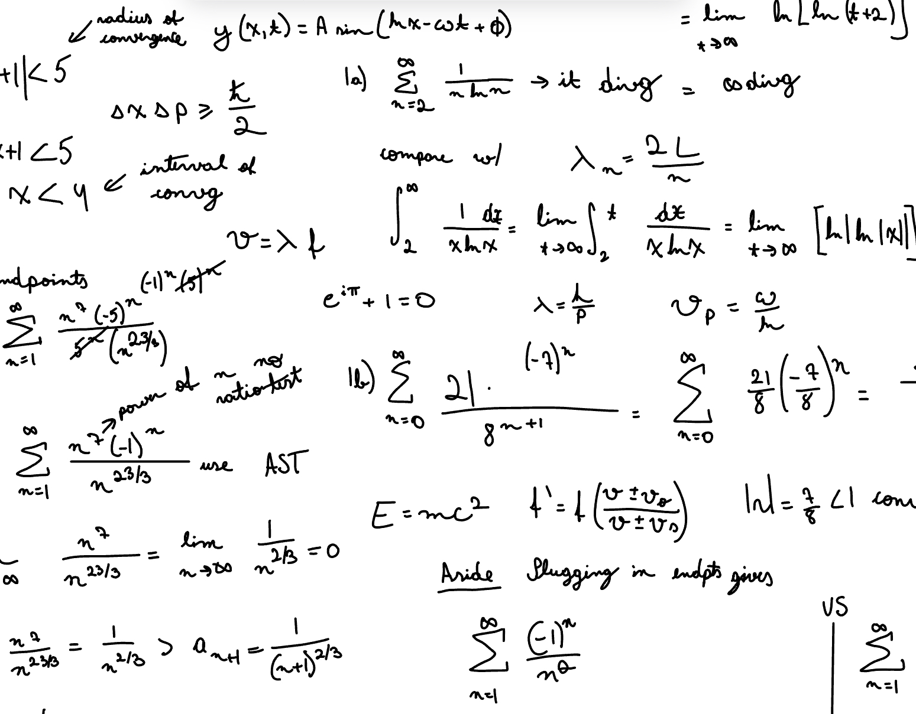
Concept Aspects
Problem -> Perfection and scale of a solar system
Solution ->
*asset drawn by team

Slide 10
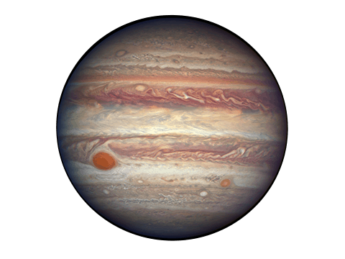
Variable Parameters
Number of planets
Style of UI
Planet masses
Speed of the simulation
Velocity of a body
“Jupiter Transparent.” Nine Planets, 2 Mar. 2020, https://nineplanets.org/planets-transparent-background/. Accessed 29 Jan. 2025.

Slide 11
Typical Input
Changing the planet system by adding and removing objects
Changing the timescale so we can simulate decades or centuries in mere minutes
Changing specific parameters of planets for full control, such as:
Mass of a body
Velocity of a body

Slide 12
Typical Output
The application responds by updating the simulation accordingly:
The forces change in real time
The orbits change their visualized path accordingly
The style of the orbit

Slide 13
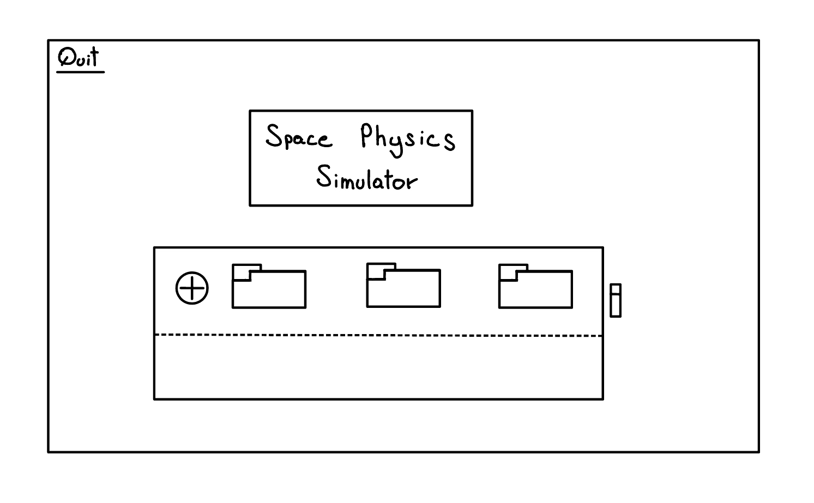
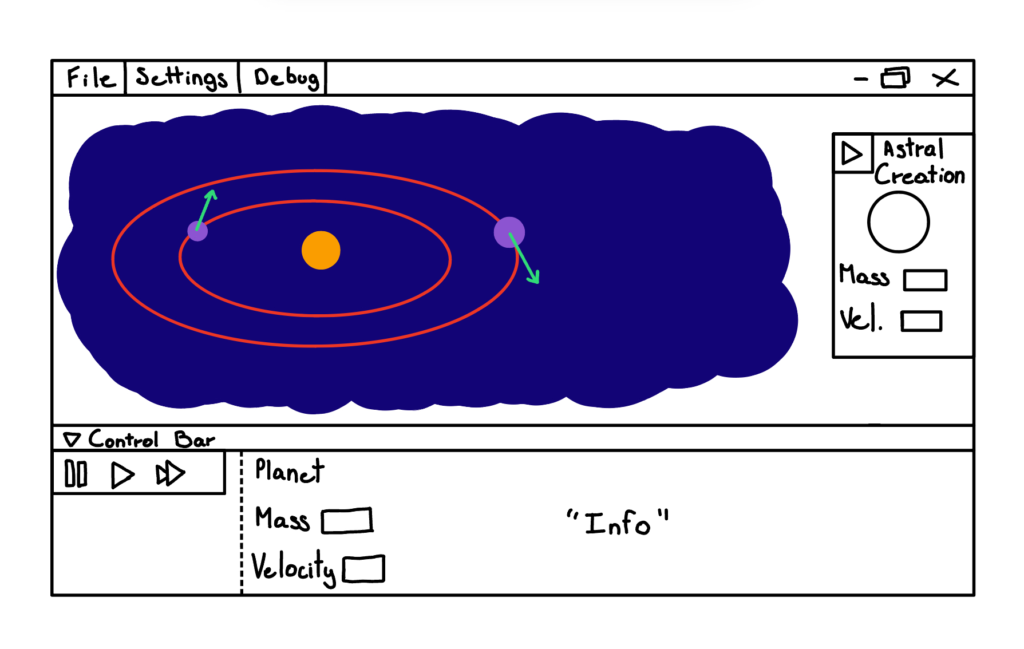
User Interface - First-Look
*assets drawn by team

Slide 14
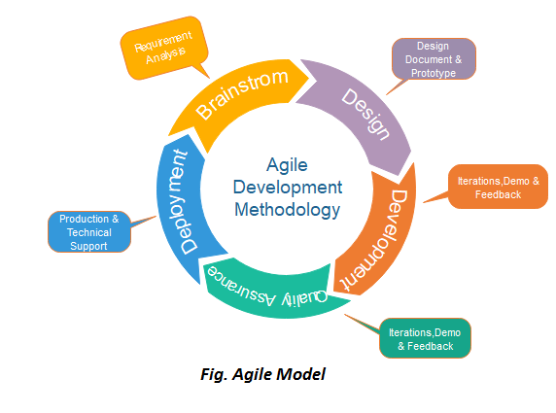
Feasibility
Agile methodology will be used
Several sprints with added-on features
Thorough task division
Established timelines
Organization using Jira
Communication
Learning from each other
Usage of Discord
“Fig. Agile Model.” Javatpoint, https://www.javatpoint.com/software-engineering-agile-model. Accessed 29 Jan. 2025.

Slide 15
JavaFX elements
Buttons
Sliders
Animations
Interpolators
Pane
Canvas
MVC
FXML with Scene Builder
Images
Radio Buttons
Text Fields
Labels
CSS
A non-exhaustive list:

Slide 16
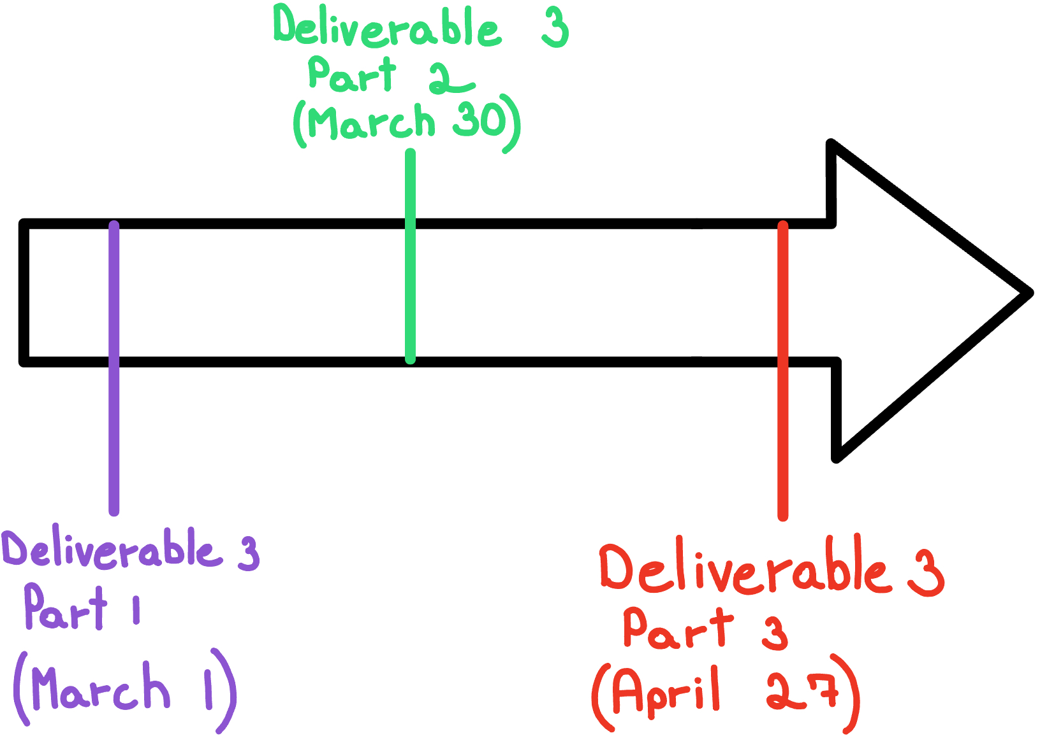
Timeline
Deliverable 3 Part 1
Class and Method Skeletons
First Implementation of User Interface
User Interface Loading Class
Design and Search for Basic Assets
Basic Frame Resizing/Camera System Implementation
Deliverable 3 Part 2
Vector Math Class
JSON File Handling Classes
Implementation of Rendering System
First Implementation of Physics Engine
Basic Scene Selector Class
Control/Inspector Panel
Deliverable 3 Part 3
Final Implementation of User Interface
Complete Development of Physics Engine
Implementation of File Watcher System
Draggable Debug Components
Documentation
ToolTips and Help Menu
Settings Menu
*asset drawn by team

Slide 17
Cristian’s Part
User interface
Menu bar
Planet control bar
Physics implementation
Kepler’s Laws
Newton’s Law of Universal Gravitation
Camera and planet close-ups
Settings menu and effects
Asset management
Saving and loading feature

Slide 18
Eric’s Part
Modification of system
Drag & Drop
Custom Planets
Set variables before initializing
UI Loading Class
Assets
Physics
Gravitational Laws
Kepler’s Laws
Saving and loading using JSON

Slide 19
Andrei’s Part
Physics
Gravitational Laws
Kepler’s Laws
Rendering
Base object / Driver class
Scene selector
Inputs
File Watcher
Draggable Arrows for velocity

Slide 20
Adriano’s Part
Various User Interface Components (Title Screen, Canvas/MainScene)
Math and Vector Classes
First Physics Implementation
Various UI Features:
Popping out menus as separate windows
Hotkeys for UI management
Settings Menu and Variables
Documentation and Help Menus

Slide 21
Works Cited
CactiStaccingCrane. “OUR SOLAR SYSTEM IMAGINE.” Wikimedia Commons, 19 Apr. 2022, https://commons.wikimedia.org/wiki/File:Solar_System_true_color.jpg.
Accessed 29 Jan. 2025.
Dna-Dennis. “Gravitational constant equation.” Wikimedia Commons, 24 Jan. 2008, https://commons.wikimedia.org/wiki/File:NewtonsLawOfUniversalGravitation.svg.
Accessed 29 Jan. 2025.
Encyclopædia Britannica, Inc. “Balkans.” Encyclopædia Britannica, https://www.britannica.com/place/Balkans/In-the-Roman-Empire#/media/1/50325/110370. Accessed
29 Jan. 2025.
“Fig. Agile Model.” Javatpoint, https://www.javatpoint.com/software-engineering-agile-model. Accessed 29 Jan. 2025.
“Jupiter Transparent.” Nine Planets, 2 Mar. 2020, https://nineplanets.org/planets-transparent-background/. Accessed 29 Jan. 2025.
Tamorlan. “Model of a beam engine.” Wikimedia Commons, 12 Apr. 2007, https://commons.wikimedia.org/wiki/File:JamesWattEngine.jpg. Accessed 29 Jan. 2025.
University of Waikato. “Kepler’s laws.” Science Learning Hub Pokapū Akoranga Pūtaiao, 27 Mar. 2013, https://www.sciencelearn.org.nz/images/277-kepler-s-laws.
Accessed 29 Jan. 2025.

